Slide 1


OVERVIEW ON
SAP PP

Slide 2
Production system
Production planning is the planning of manufacturing requirements such as manpower, materials, machines and manufacturing process in order to arrive at the desired product, parallelly satisfying current planned levels of sales, while meeting the firm’s general objectives regarding profit, productivity, lead times and customer satisfaction.
OBJECTIVES OF PP
Production of quality products
Maximum utilization of resources
Economy at production time
Optimum inventory level maintenance
Ensure smooth flow of operation

Slide 3
Production Planning- Decision Making
PRODUCT PLANNING & DEVELOPMENT INCLUDING PRODUCT DESIGN
PRODUCT SCHEDULING AND MACHINE LOADING
WHAT TO PRODUCE?
WHEN TO PRODUCE?
MATERIAL PLANNING, PROCESS PLANNING, TOOL AND EQUIPMENT PLANNING
HUMAN RESOURCE PLANNING
HOW TO PRODUCE?
WHO WILL PRODUCE?
FACILITIES PLANNING, CAPACITY PLANNING AND SUBCONTRACTING
ECONOMIC BATCH SIZE
WHERE TO PRODUCE?
HOW MUCH TO PRODUCE?

Slide 4
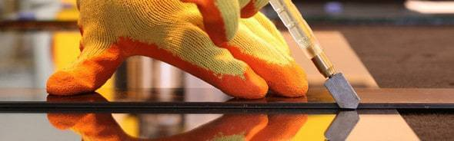
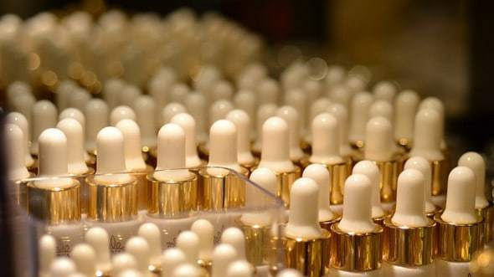
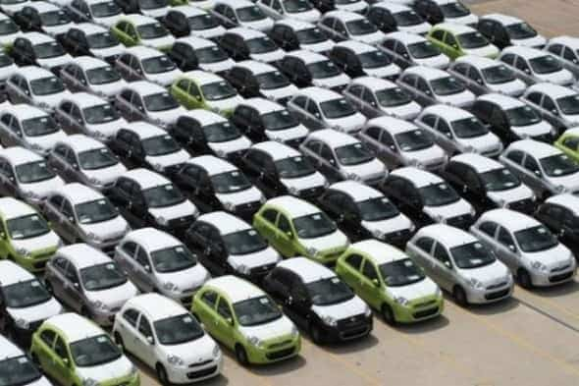

Types of Production
UNIT OR JOB-TYPE
BATCH-TYPE
MASS OR FLOW TYPE
CONTINUOUS TYPE

Slide 5
Unit or Job shop Production
Job shops are typically small manufacturing systems that handle job production, that is, custom or semi-custom manufacturing processes such as small to medium-size customer orders or batch jobs.
Types of common job shops are grinding, honing, jig-boring, gear manufacturing, and fabrication shops.

Slide 6
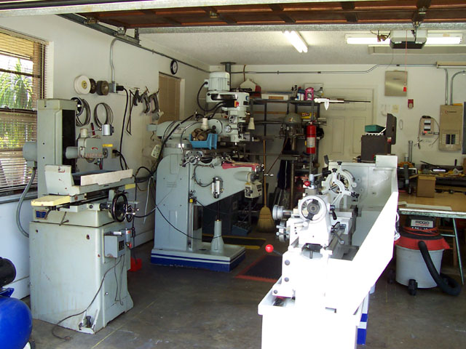
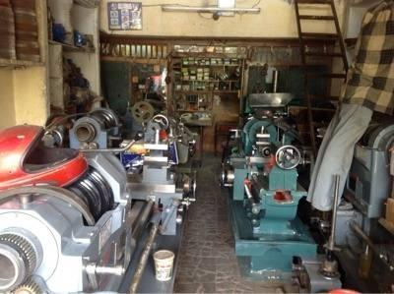
Job Shop Production

Slide 7
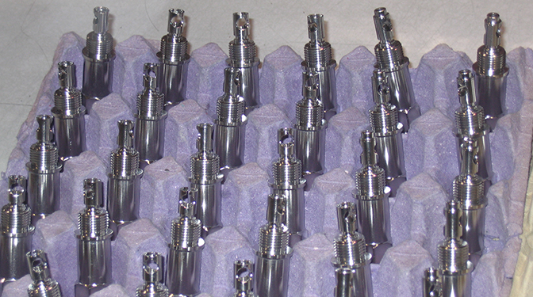
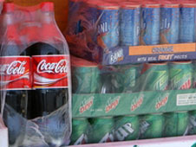
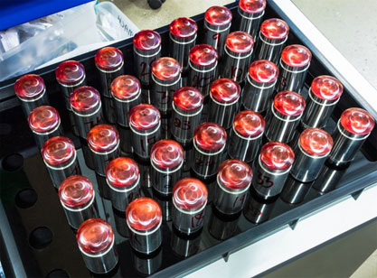
Batch Production
The products are made in small batches and in large variety. Each batch contains identical items but every batch is different from each other.

Slide 8
Mass Production
Mass production is the manufacture of large quantities of standardized products, frequently utilizing assembly line technology. Mass production refers to the process of creating large numbers of similar products efficiently.
Low variety and high volume of products.
Flow of material is continuous.
Electronics, Electricals, Automobiles and containers are the examples of mass production.

Slide 9
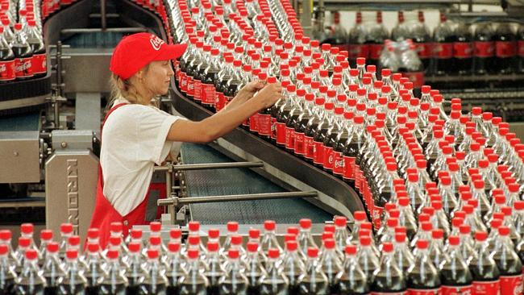
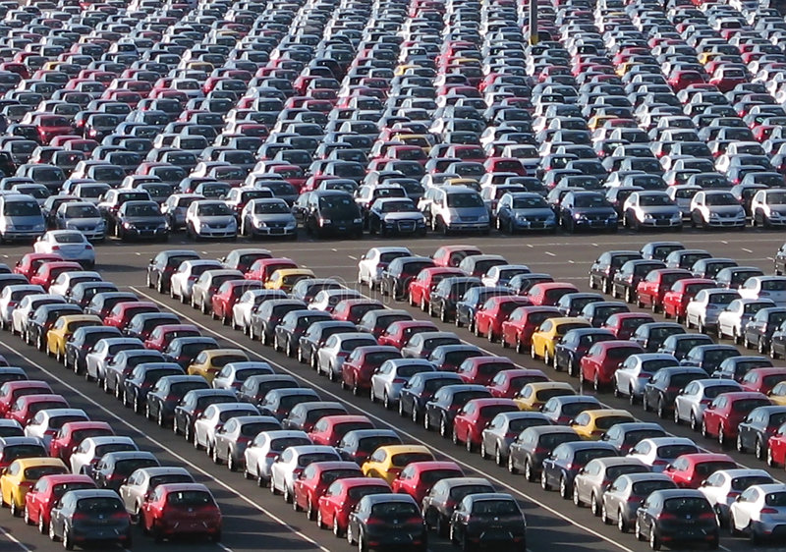
Mass Production

Slide 10
Process production
This type of production is used for manufacture of those items whose demand is continuous and high.
Single raw material can be transformed into different kind of products at different stages of the production processes.
Paper, textiles, cement, chemicals and automobiles are the few examples of process production.

Slide 11
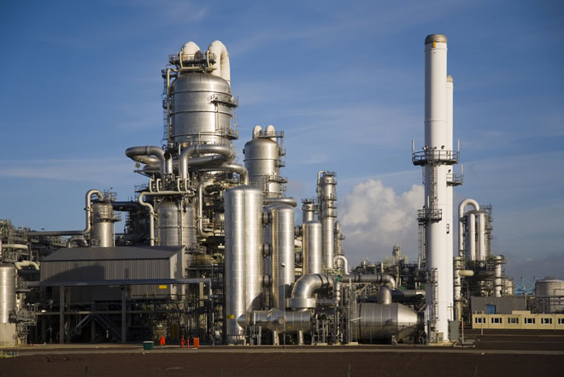
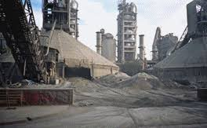
Process Production

Slide 12
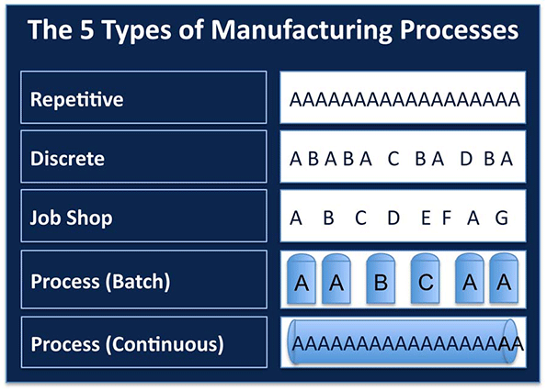
Types of Manufacturing process
Discrete
Repetitive
Process

Slide 13
Discrete Manufacturing process
Discrete manufacturing is an industry term for the manufacturing of finished products that are distinct items capable of being easily counted, touched or seen.
Discrete manufacturing involves parts and systems like nuts and bolts, brackets, wires, assemblies and individual products.

Slide 14
Repetitive Manufacturing
Repetitive manufacturing (REM) is the production of goods in rapid succession.
Goods that are created through repetitive manufacturing follow the same production sequences. Repetitive manufacturing often goes hand-in-hand with automated assembly processes. It is a useful approach when the same (or similar) products are produced over a lengthy period of time.
Examples are sugar industries, rice industries, Ancillary equipment's like spare parts

Slide 15
Process Industries
Process manufacturing is the branch of manufacturing that is associated with formulas and manufacturing recipes.
Manufacturing Verticals
Food and Beverage
Intra venous products
Paints and coatings
Specialty chemicals
Bulk-drug pharmaceuticals
Cosmeceuticals

Slide 16
PP Organizational structure
Client
An independent environment in the system
Company Code
Smallest org unit for which you can maintain a legal set of books
Plant
Operating area or branch within a company
Manufacturing, distribution, purchasing or maintenance facility
Storage Location
An organizational unit allowing differentiation between the various stocks of a material in a plant
Work Center Locations
An organizational unit that defines where and when an operation is performed

Slide 17
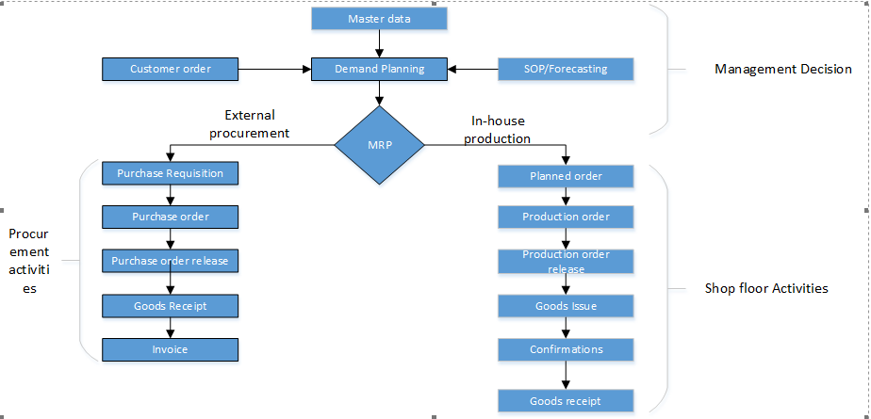
Production planning flow

Slide 18
Planning Phase-Organization Structure
Client
Company Code
Plant
FG Tank
FG Barrier
FG Portable Restroom
FG Pallets
FG Bins & Trolley
Raw Materials
Consumables
Storage Location

Slide 19
Planning Phase-Master data
Material master
Bill of Materials (BOM)
Routing
Work Center & PRT
Production version
Class and Characteristics

Slide 20
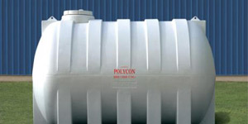
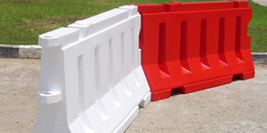

Planning Phase - Material Master
Water Storage Tank
Track / Road Barriers
Car / Tank shed

Slide 21
Planning Phase - Product Structure(BOM)
A bill of materials or product structure is a list of the raw materials, sub-assemblies, intermediate assemblies, sub-components, parts and the quantities of each needed to manufacture an end product.
Types of product structures,
1. Single level BOM
2. Multilevel BOM
3. Variant BOM
4. Multiple BOM

Slide 22
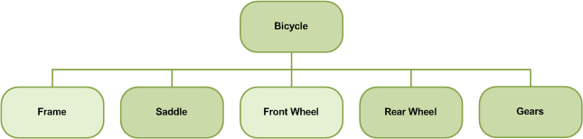
Single level product structure

Slide 23
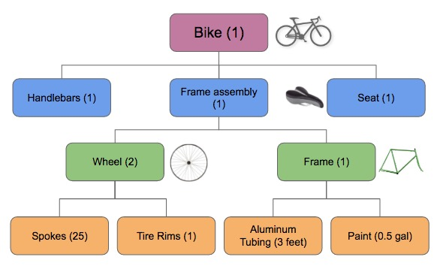
Multi level Product structure

Slide 24
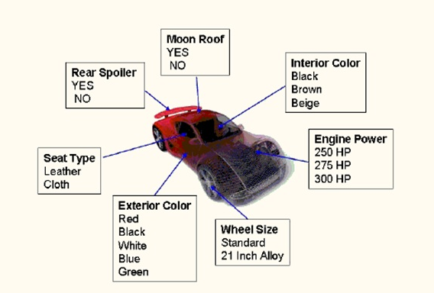
Variant product structure
A variant BOM groups together several BOMs that describe different objects (for example, products) with a high proportion of identical parts.

Slide 25
Multiple BOM
A multiple BOM groups together several BOMs that describe one object (for example, a product) with different combinations of materials for different processing methods.

Slide 26
Bill Of Materials
Horizontal Storage Tank (FG)
Semi Finished Tank (SFG)
LLDPE Powder (SFG)
LLDPE Granules (RM)

Slide 27
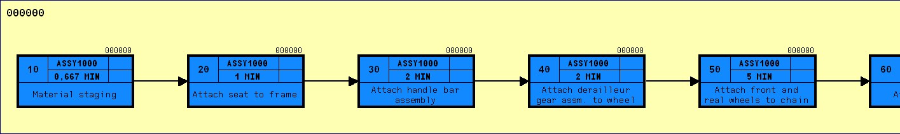

Planning Phase-Routing
A routing is a description of which operations or list of activities has to be carried out during the production and planning process.

Slide 28
Planning Phase-Routing – SFG-1
Pulverization
Loading of LLDPE Granules
Unloading of LLDPE Powder & Packing
Quality Inspection

Slide 29
Planning Phase-Routing – SFG-2
Metering & Loading LLDPE Powder in Mold
Cooling & Curing
Heating & Molding
Unloading & Quality Inspection
Metering & Loading LLDPE Powder in Mold for second Layer
Heating & Molding

Slide 30
Planning Phase-Routing-FG
Cleaning the tank
Packing the Tank
Quality Inspection

Slide 31
Planning Phase - Work center
An organizational unit that defines where and when an operation must be performed.
The work center has an available capacity. The activities performed at or by the work center are valuated by charge rates, that are determined by cost centers and activity types. Work centers can be Machines, People, Production lines and Groups of craftsmen.
Data in work centers is used for
Scheduling:
Operating times and formulas are entered in the work center, so that the duration of an operation can be calculated.
Costing:
Formulas are entered in the work center, so that the costs of an operation can be calculated. A work center is also assigned to a cost center.
Capacity planning:
The available capacity and formulas for calculating capacity requirements are entered in the work center.
Simplifying operation maintenance:
Various default values for operations can be entered in the work center.

Slide 32
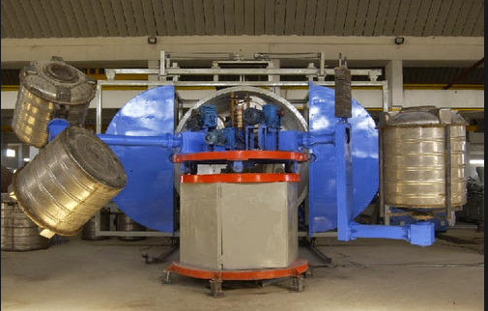
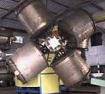
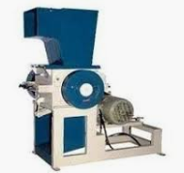
Planning Phase - Work Center & PRT
Bi Axial rotomoulding Mc
Mold and Die (PRT)
Grinding machine

Slide 33
Planning Phase - Production version
When there is more than on BOM or routing for a single product (FG/SFG), the selection of the appropriate BOM and routing is done with the help of production version.
It is a combination of BOM and routing.
Example: A material ABC has 3 BOMs and 2 routings. In that case, there can be a maximum of 6 production versions of the following combination:
a. PV1: BOM 1: ROUTING 1
b. PV2: BOM 1: ROUTING 2
c. PV3: BOM 2: ROUTING 1
d. PV4: BOM 2: ROUTING 2
e. PV5: BOM 3: ROUTING 1
f. PV6: BOM 3: ROUTING 2
BOM | ROUTING
1 | 1
2 | 2
3

Slide 34
Planning Phase - Class and characteristics
Class is used to hold the characteristics that describe the properties of the material.
Types of classes.
Variant class(300)
Batch Class(023)
Material Class(001 or 100)

Slide 35
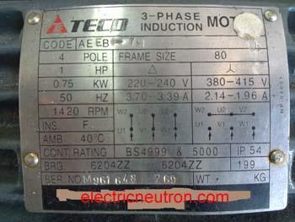
Planning Phase - Class and characteristics
Class | Characteristics | Value
Dosing pumps | Tag No | OH1
 | Serial No | S142682
 | Model Number | A24362
 | Type(specific Name) | Plunger
 | Stages | 2
Rotor balancing | Tag No | OH2
 | Model Number
 | Shaft dia | 60 mm
 | Impeller Dia | 130mm
 | Weight | 50
 | Speed RPM | 2500 RPM

Slide 36
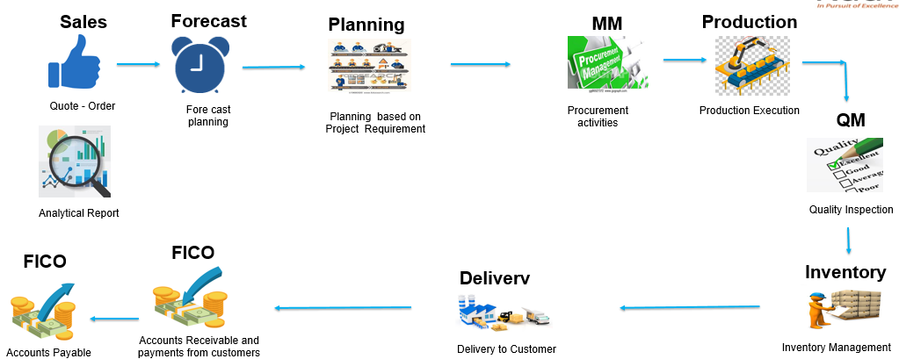
Planning Phase – Business Flow

Slide 37
Planning strategies
To create the demand program, you must define the planning strategy for a product. Planning strategies represent the methods of production for planning and manufacturing or procuring a product.
Make to stock(MTS)
Net requirement planning
Gross Requirement planning
Make to order(MTO)
Assemble to order(ATO)

Slide 38
Net and Gross Requirements Planning
Net Requirements Planning (10):
The make-to-stock strategy gross requirements planning is particularly useful in mass production environments; it is often combined with repetitive manufacturing. This strategy is particularly useful if you need to produce, regardless of whether you have stock or not.
Gross Requirements Planning(11):
This planning strategy is particularly useful in mass production environments; it is often combined with repetitive manufacturing. You should choose this strategy if you want production to be determined by a production plan (Demand Management) and if you do not want sales orders to influence production directly.
Strategy | 10 | 11
Stock is taken into account | Yes | No

Slide 39
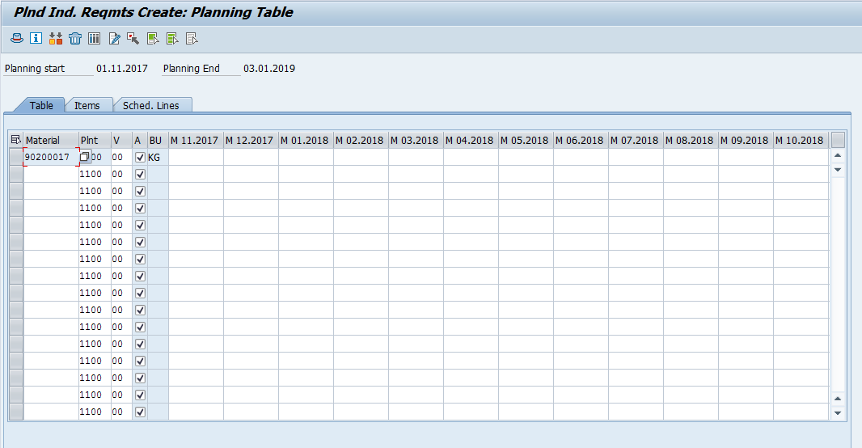
Demand Management – Master Production Schedule
The function of Demand Management is to determine requirement quantities and delivery dates for finished products assemblies.
Customer requirements are created in sales order management.

Slide 40
Planning Phase - Production planning
Production Planning & Execution
Long term Planning (LTP)
Material Requirement Planning (MRP)
Consumption Based Planning (CBP)

Slide 41
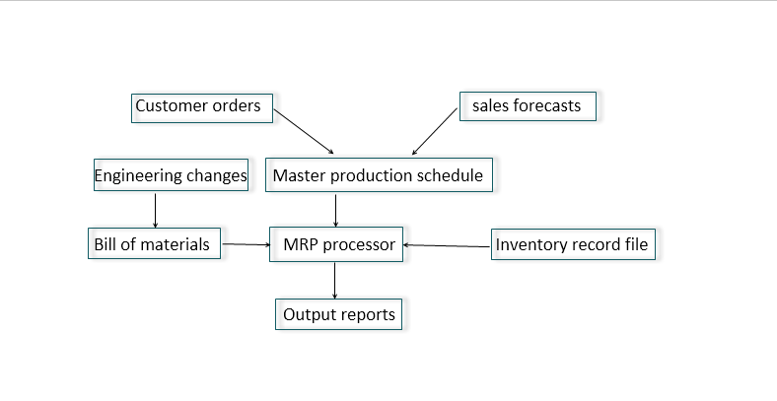
Material Requirement Planning

Slide 42
Material Requirement Planning
MRP is used to ensure the availability of materials based on the need generated by MPS or the Demand Program
5 Logical Steps are calculating during MRP run
Net Requirements Calculation
Lot Size Calculation
Procurement Type
Scheduling
BOM Explosion

Slide 43
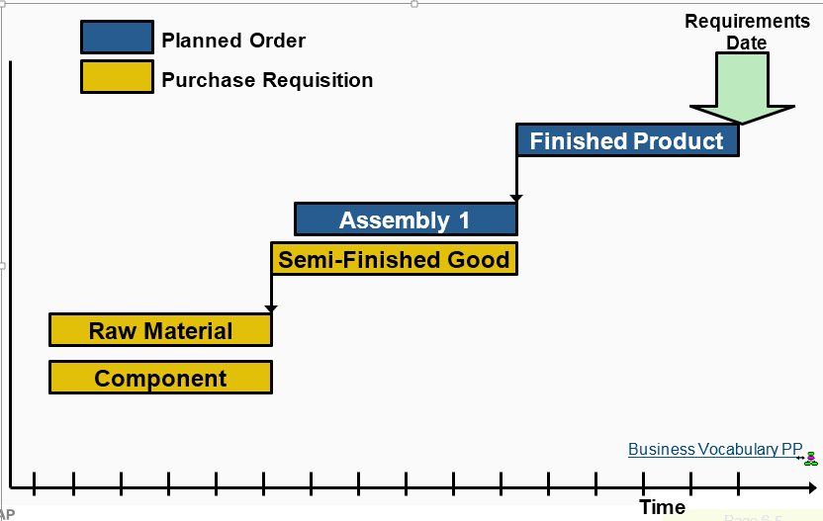
Multi Level scheduling

Slide 44
Consumption Based Planning
It consists of three types, they are
Forecast based planning
Reorder point planning
Time phased planning

Slide 45
Planning Phase - Forecasting
To estimate the future demand for the product is based on past consumption of the product.
Sales, Production, Inventory
4,000,000
3,500,000
3,000,000
2,500,000
Sales
2,000,000
Production
1,500,000
Inventory
1,000,000
500,000
January
February
March
April
May
June
July
August
October
September
November
December

Slide 46
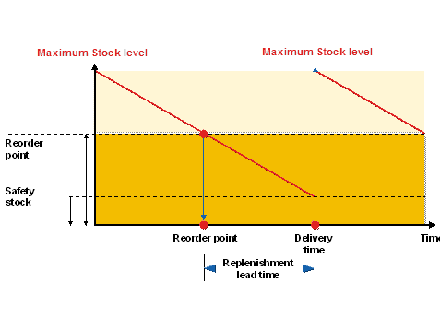
Planning Phase - Reorder Point Planning
In reorder point planning, procurement is triggered when the sum of plant stock and firmed receipts falls below the reorder point.

Slide 47

Planning Phase - Time Phased planning
If a vendor always delivers a material on a particular day of the week, it makes sense to plan this material according to the same cycle, in which it is delivered.

Slide 48
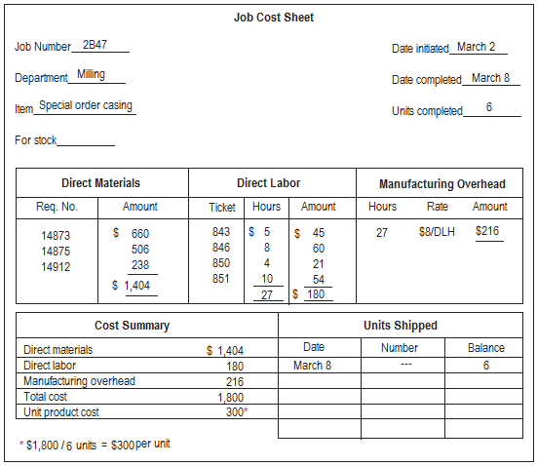
Execution & Controlling Phase - Shop floor Activities
Production order & release

Slide 49
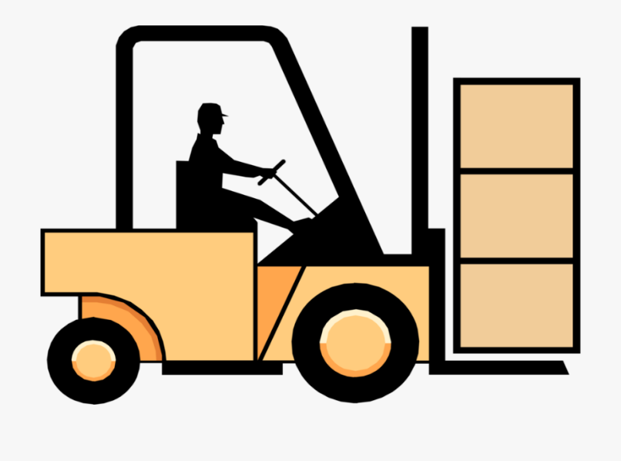
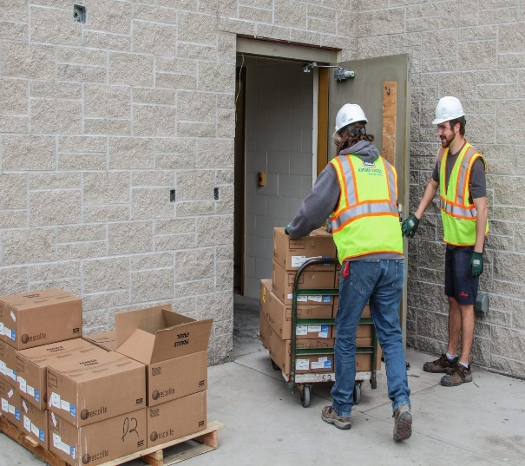
Execution & Controlling Phase - Shop floor Activities
Material Staging & Goods Issue

Slide 50
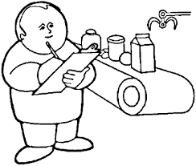
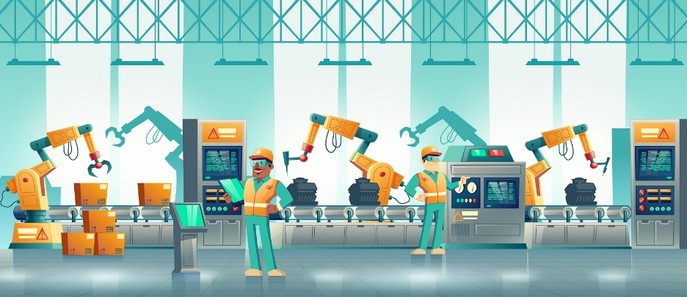
Execution & Controlling Phase - Shop floor Activities
Production Monitoring and Confirmations
A confirmation document is the processing status of orders, operations, sub-operations and individual capacities. It is an instrument for controlling orders.

Slide 51
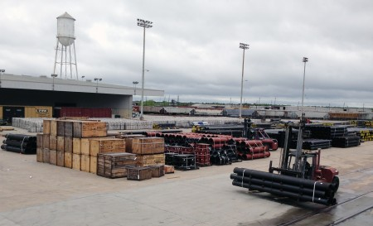

Execution & Controlling Phase - Shop floor Activities
Goods Receipt and Quality Inspection

Slide 52

THANK YOU
Redefine your business model with

